Slide 1
Self-supervised learning for medical image analysis using image context restoration
霍晓来 2020.10.22

Slide 2
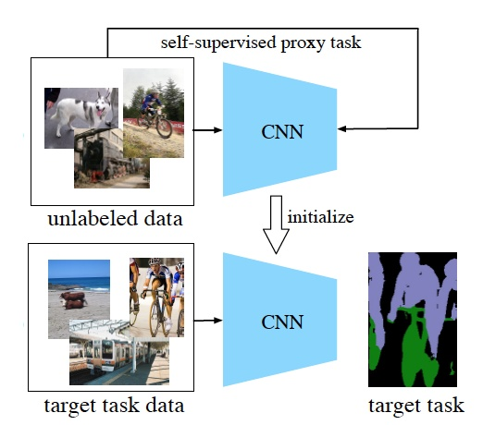
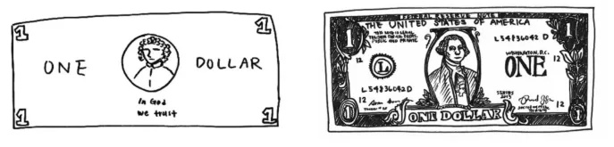

Slide 3
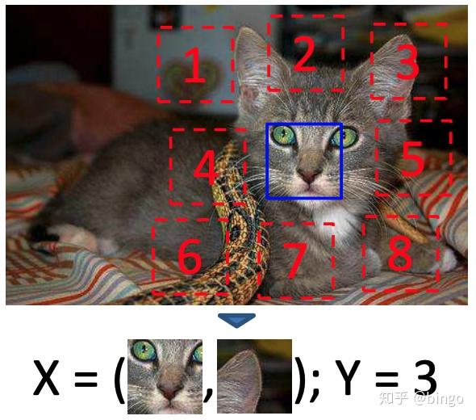
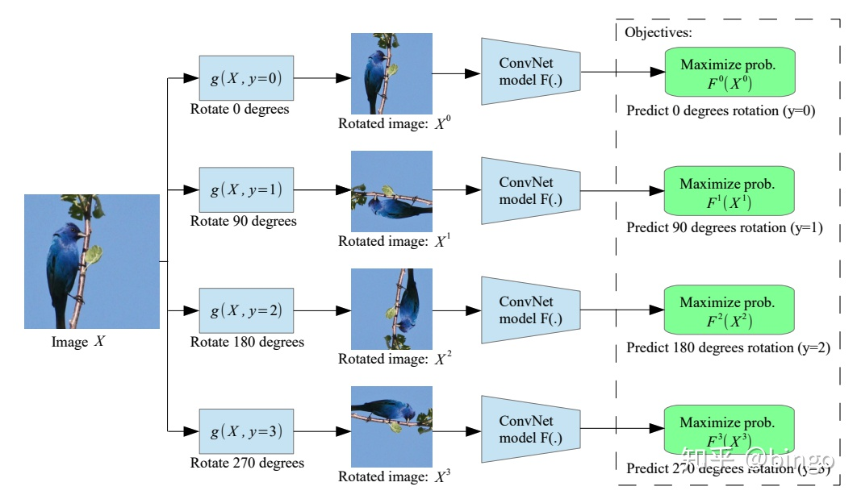
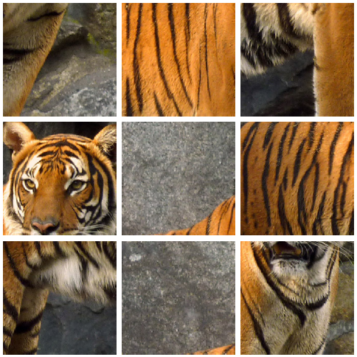
Context Prediction |  | Unsupervised Visual Representation Learning by Context Prediction
Predicting Image Rotations |  | UNSUPERVISED REPRESENTATION LEARNING BY PRE_x0002_DICTING IMAGE ROTATIONS
Solving Jigsaw Puzzles |  | Unsupervised Learning of Visual Representations by Solving Jigsaw Puzzles

Slide 4
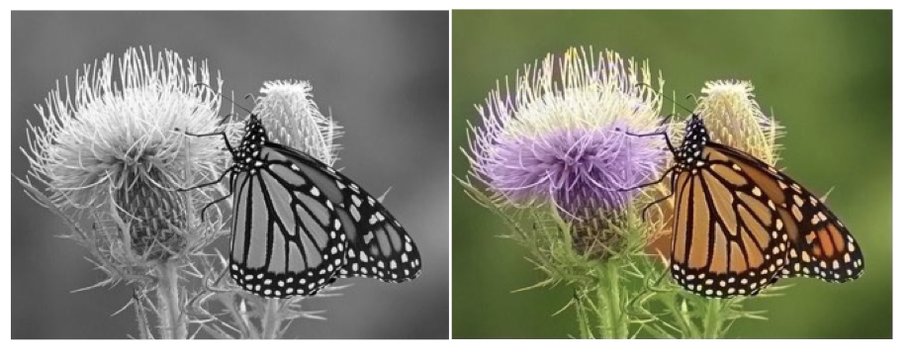
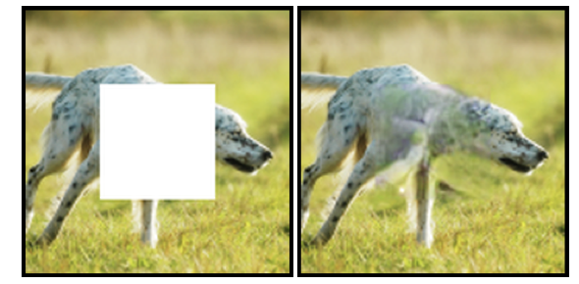
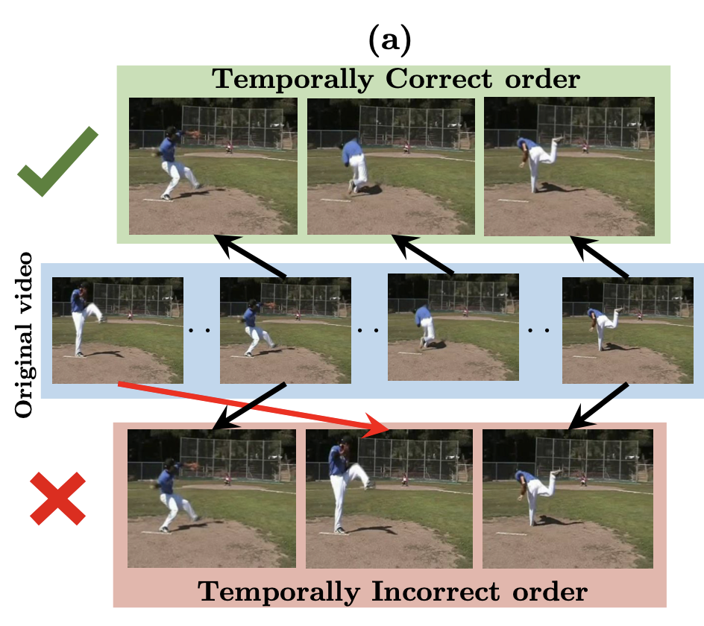
Colorful Image Colorization |  | Colorful Image Colorization
Inpainting |  | Context Encoders: Feature Learning by Inpainting
Temporal Order Verification |  | Shuffle and Learn: Unsupervised Learning using Temporal Order Verification

Slide 5
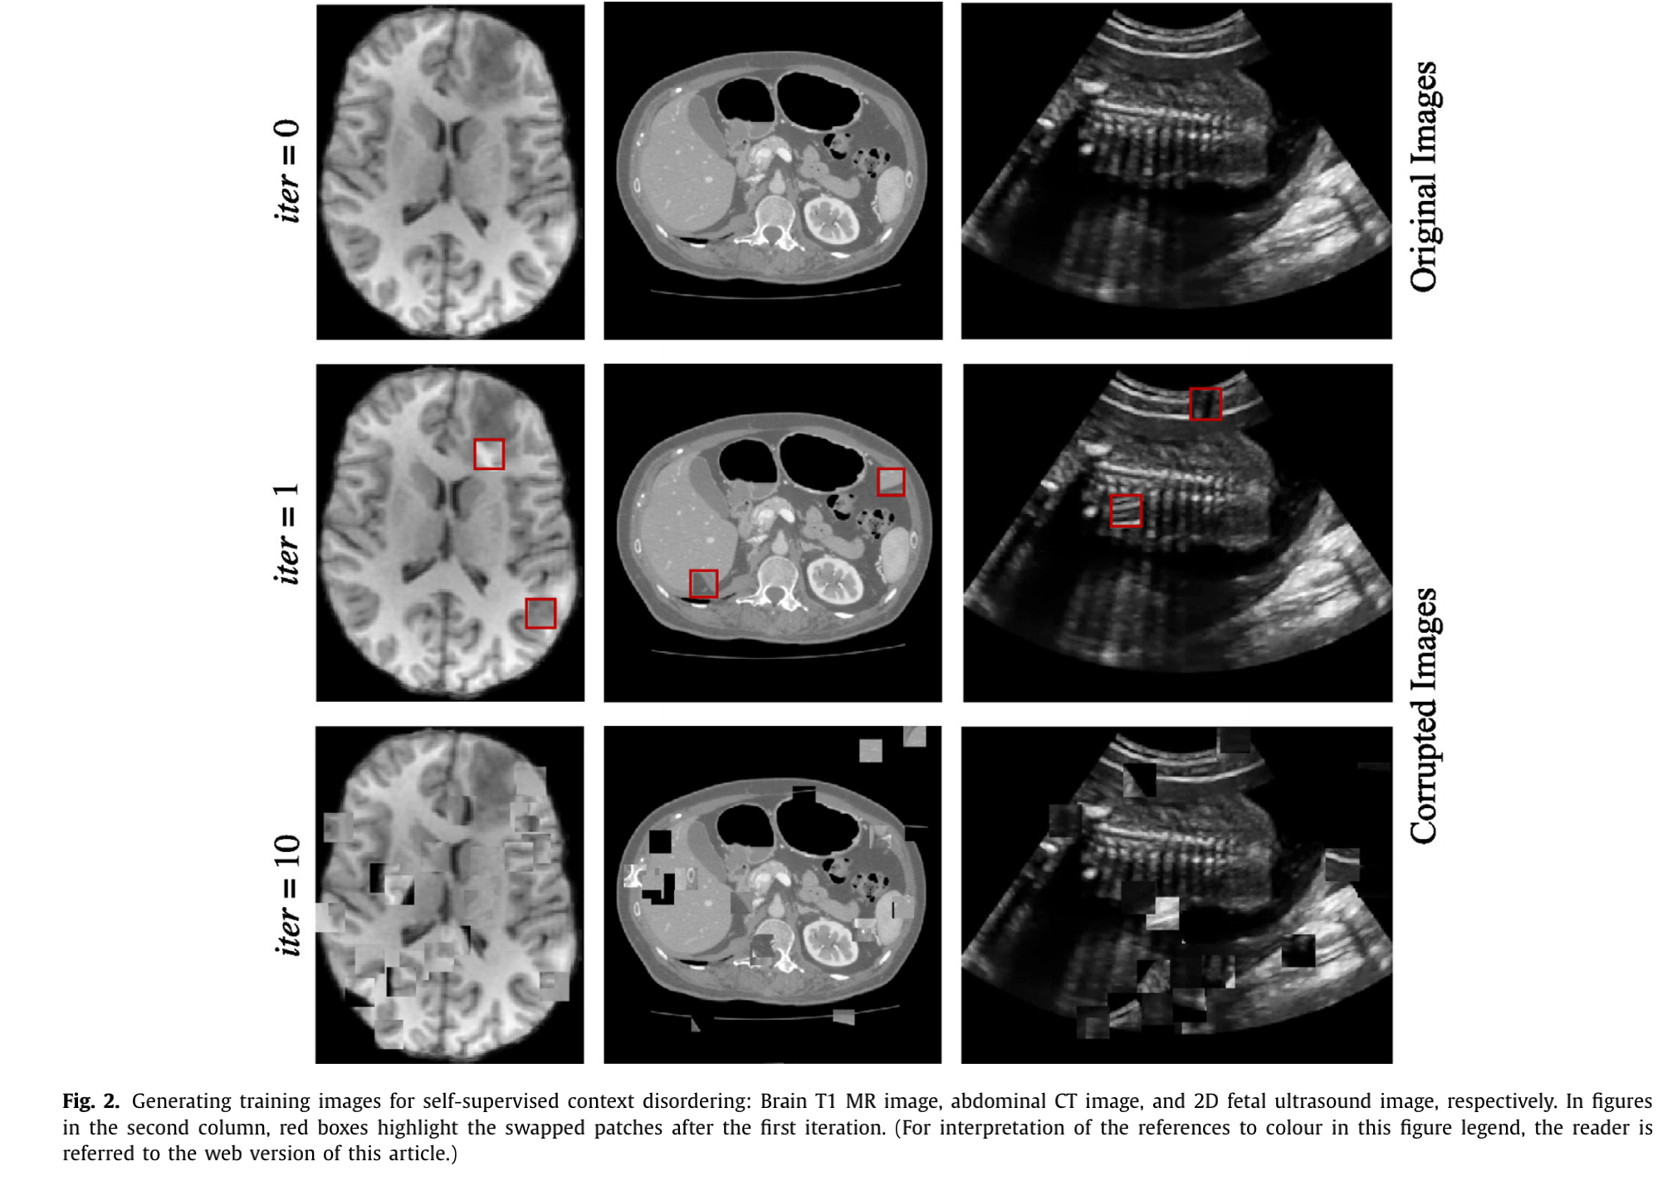
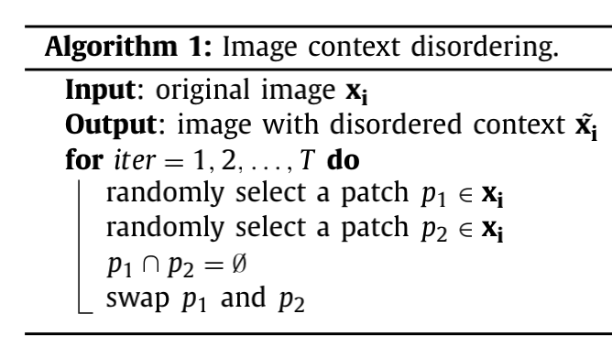
context restoration

Slide 6
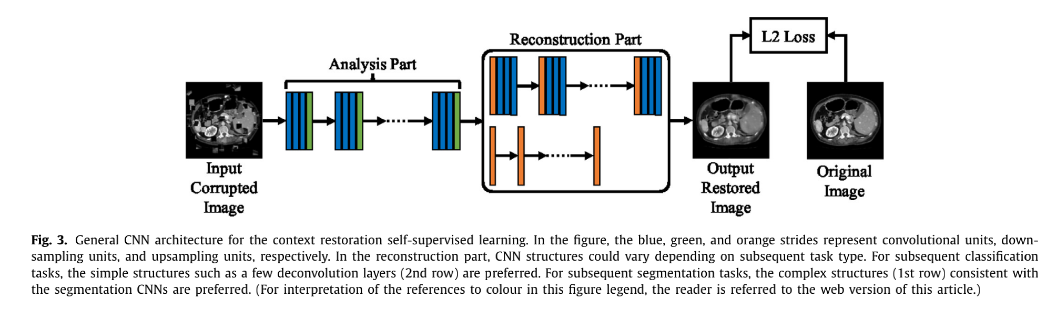
Network architectures

Slide 7
Experiments and results
classification —— fetal 2D ultrasound images
localization —— abdominal CT image
segmentation —— brain MR images

Slide 8
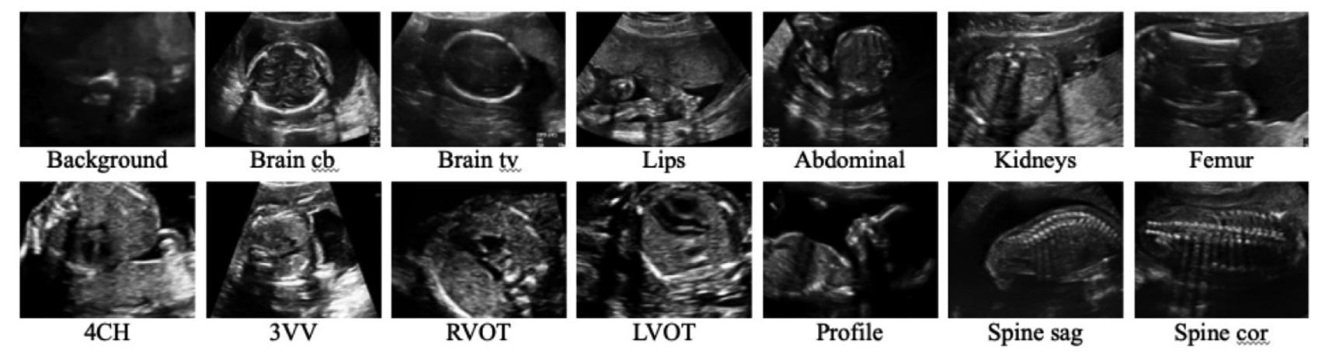
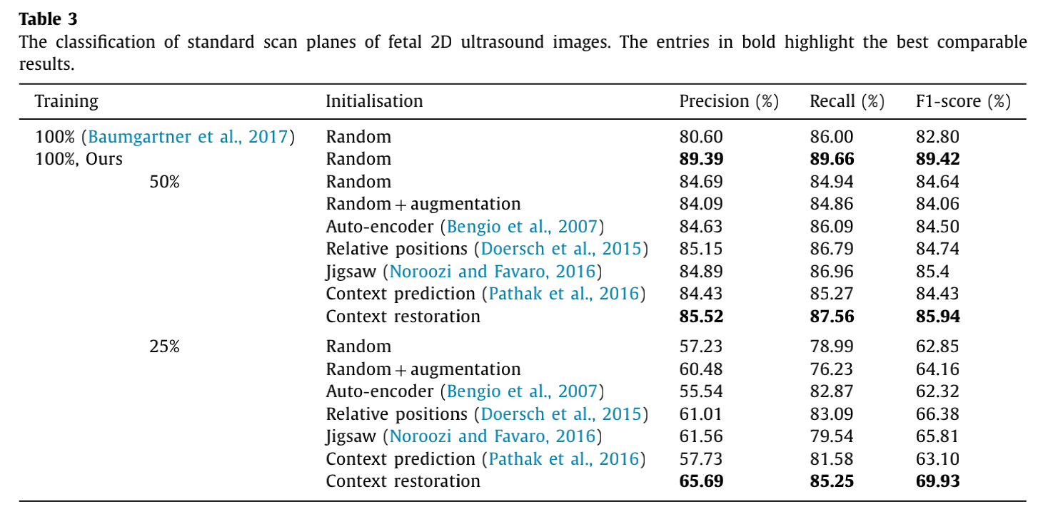
Fetal standard scan plane classification

Slide 9
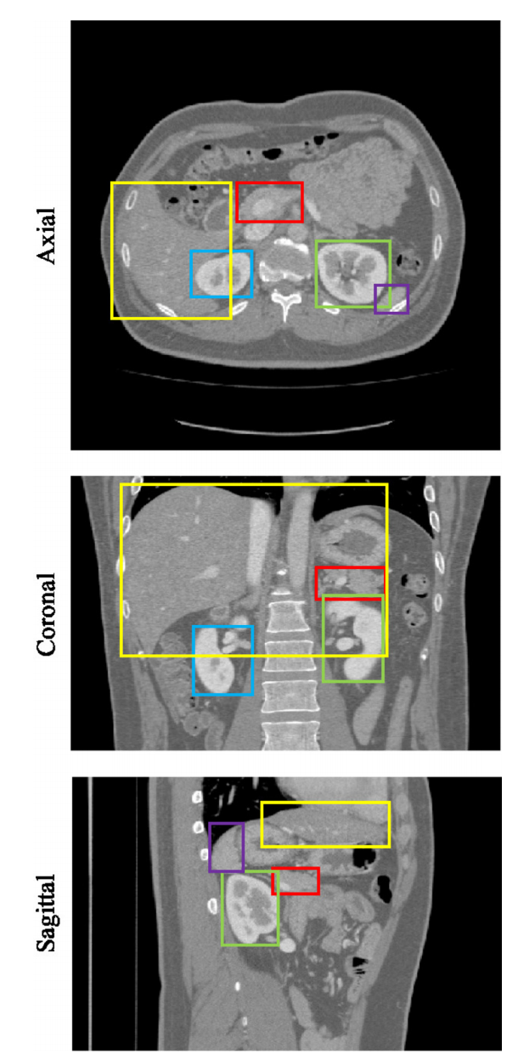
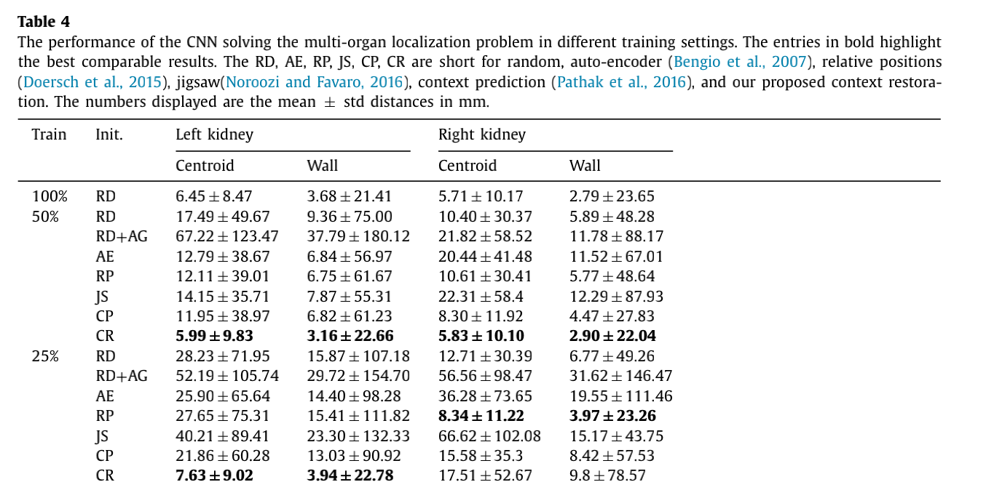
Abdominal multi-organ localization

Slide 10
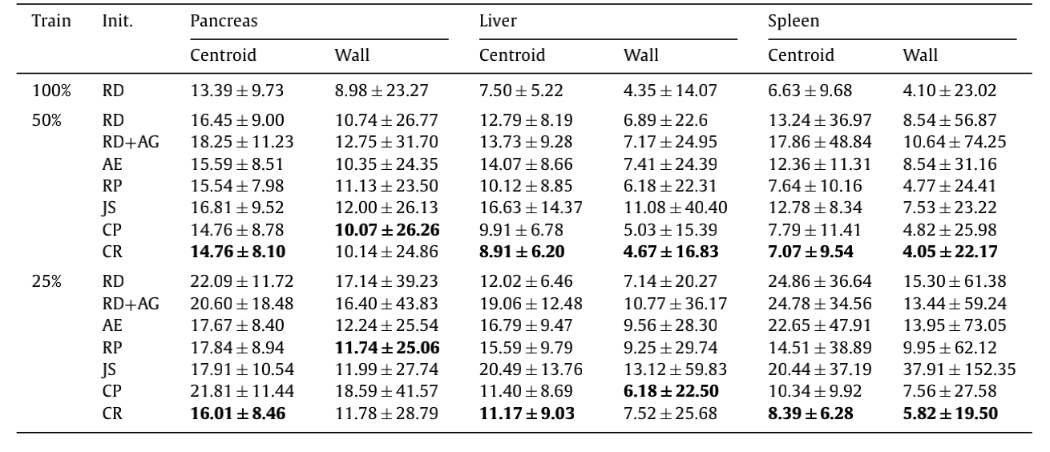
Abdominal multi-organ localization

Slide 11
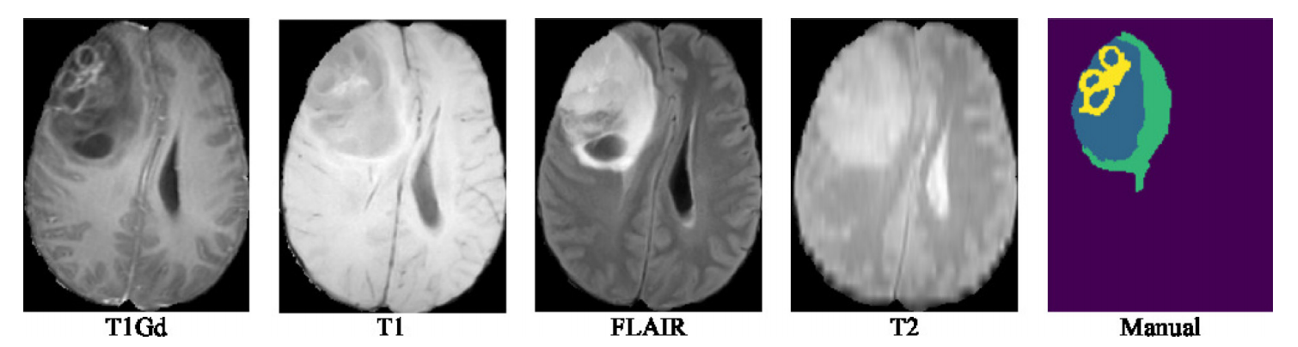
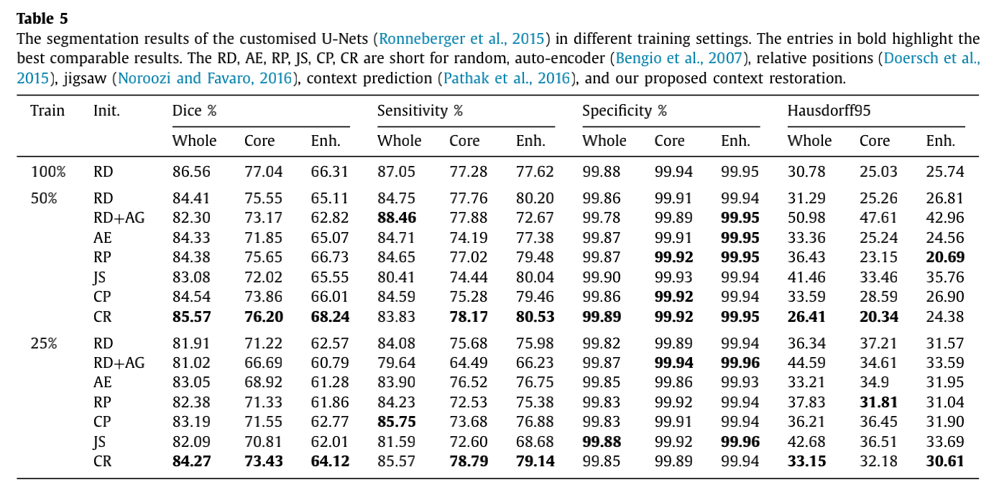
Brain tumour segmentation

Slide 12
Conclusion and thinking
How to learn more efficient image semantics ?
How to use it for our task ?

Slide 13
THANKS

